Slide 1

Ama sushi Website Content

Slide 2
Home page Website Content

Slide 3
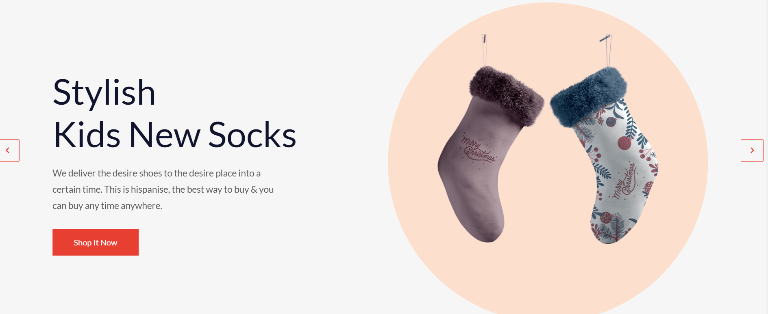
Slider section
Header 1500 x 850
Paragraph

Slide 4
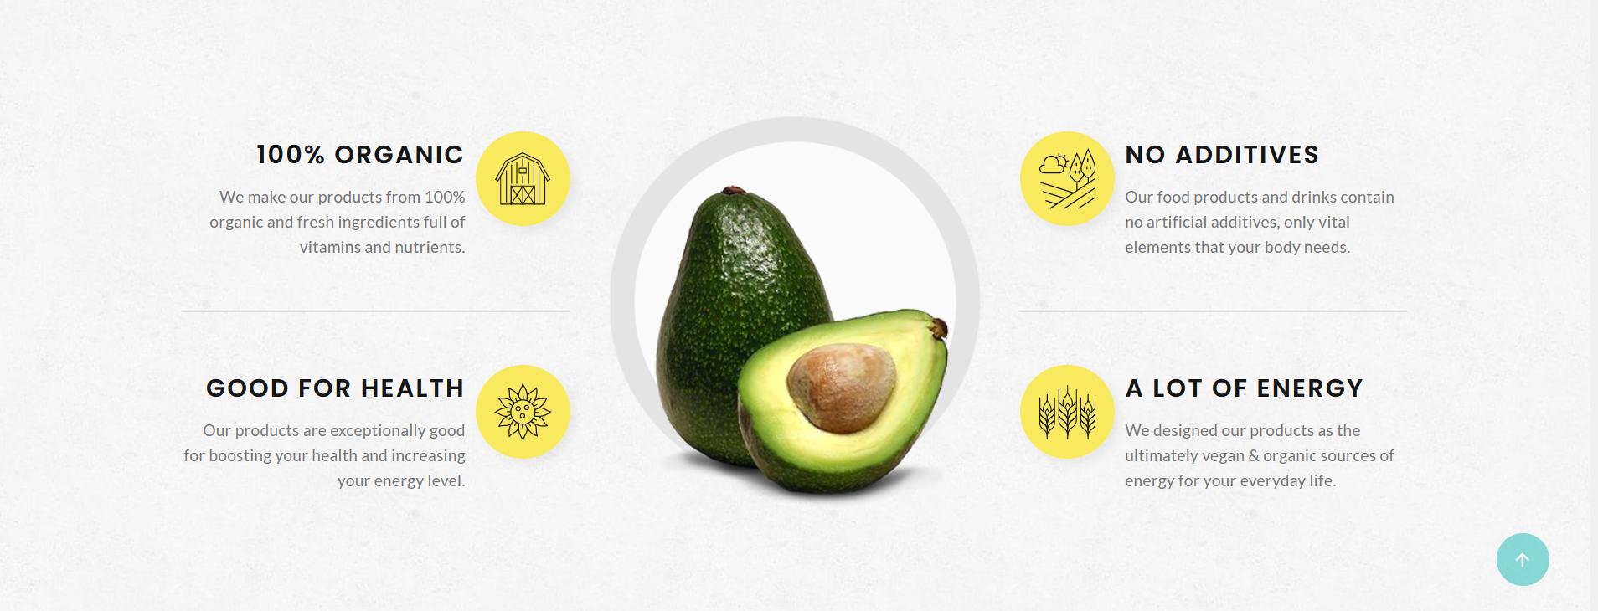
About Us
Image 400 x 400
Header
paragraph

Slide 5
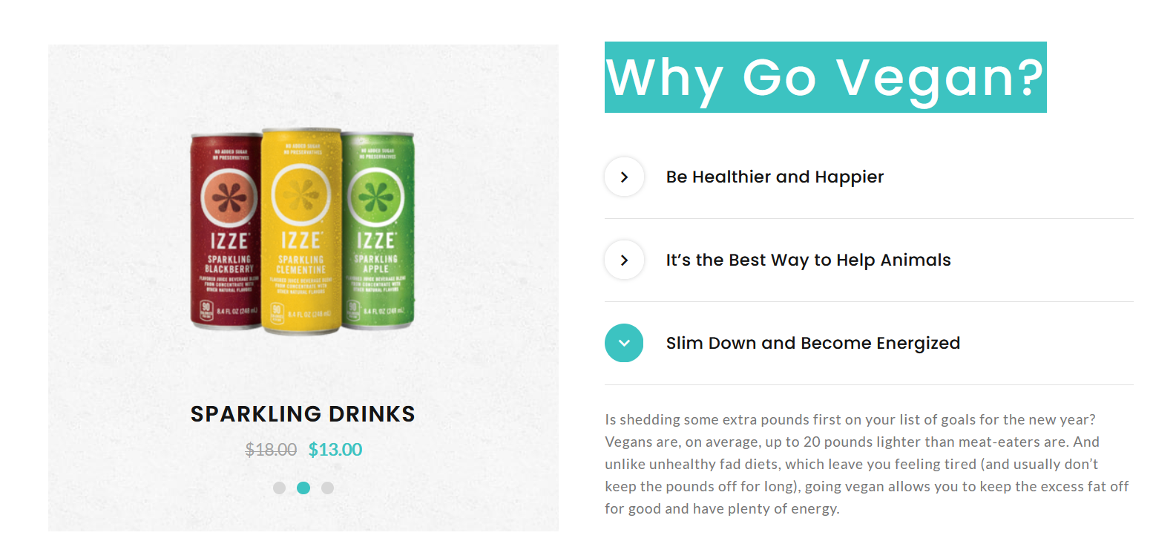
Why ritonka
Image slider 250 x 250
Title
paragraph

Slide 6
Gallery
All rights reserved by (Logo) © 2021

Slide 7
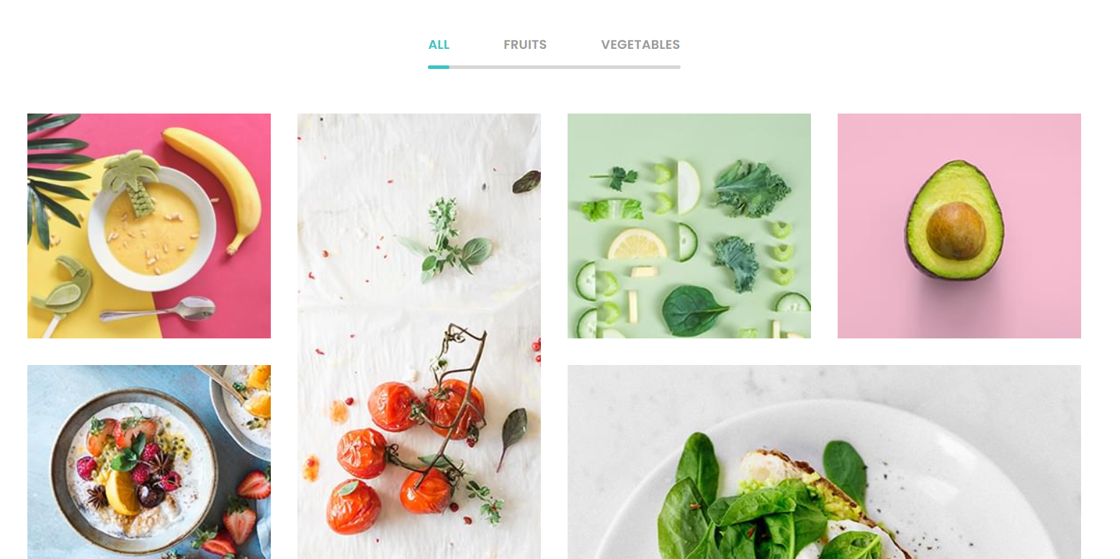
Gallery
category
Images 250 x 250

Slide 8
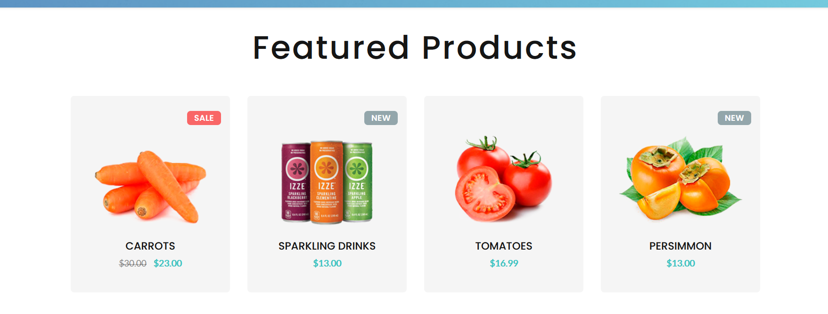
products
Title
price
Images 250 x250

Slide 9
About page Website Content

Slide 10

About us
paragraph
title
Image 450 x 650

Slide 11
Inner page Website Content

Slide 12
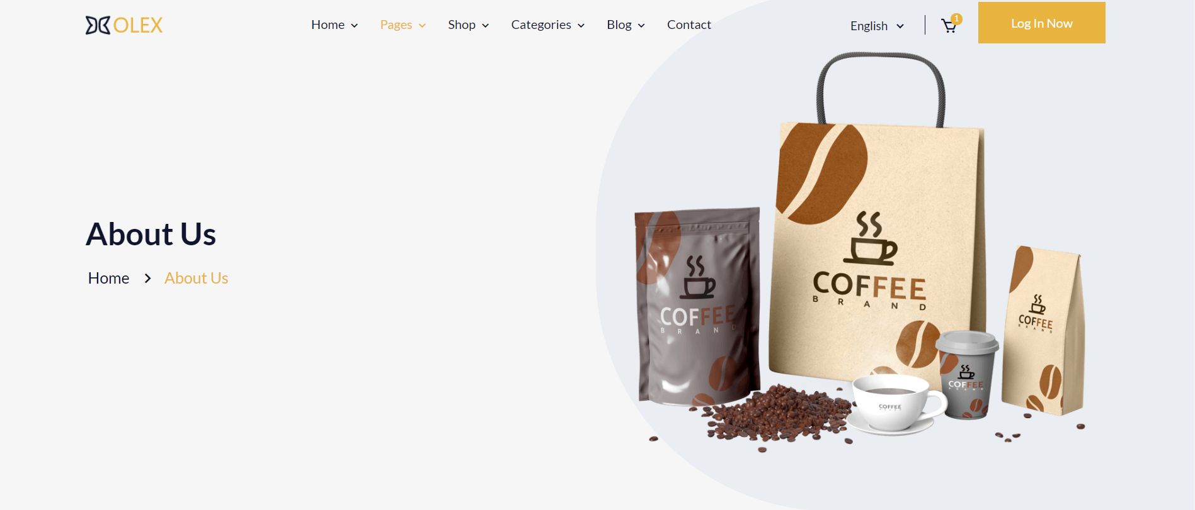
About us
Image 1500 x 650

Slide 13
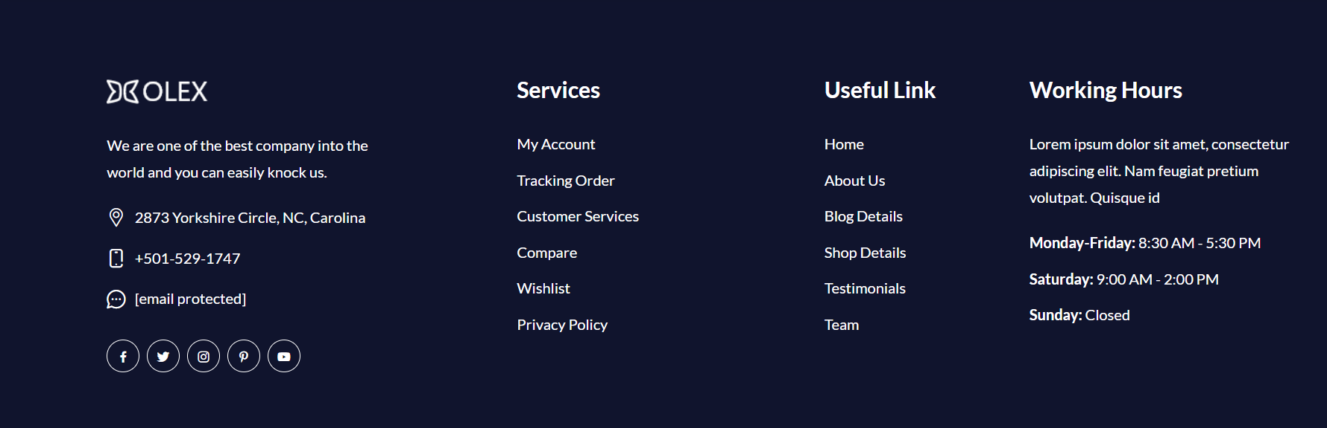
footer

Slide 14


